Slide 1
DATA MINING AND ANALYTICS TOPIC: Colour Detection in RGB format Using OpenCV and Pandas in Python
GROUP MEMBERS:
NAME: REG. NO.
ARYAN RAI RA1911003010221
RAHUL RAI RA1911003010227
AYUSH AGRAWAL RA1911003010231
SUBRAT KUMAR RA1911003010248

Slide 2
ABSTRACT:
Colour detection is the process of detecting name of the colour. Here this is easy task for humans to detect the colour and choose one.
Many of the project and research papers are written on this problem. But we use different techniques for this project. Naive Bayes algorithm, Pandas and OpenCV libraries used in python languages.
Naive Bayes may be a simple technique for constructing classifiers: models that assign class labels to problem instances, represented as vectors of feature values, where the category labels are drawn from some finite set.
Open-Source Computer Vision Library. OpenCV was designed for computational efficiency and with a robust specialize in real-time applications.

Slide 3
CONTD…
The main objective of this application is the methodology for identifying the shades of colours with an exact prediction with their names.
The main goal of our project is classification of different colour shades using machine learning under ideal and different non-ideal conditions
In this project, we used a binary classification technique of supervised learning to classify different colours.

Slide 4
INTRODUCTION:
Colour detection is simply the process of identifying the name of any colour. It is obvious that humans perform this action naturally and do not put any effort in doing so.
While it is not the case for computers. Human eyes and brain work in co-ordination in order to translate light into colour
The same strategy is useful in detecting colour names in this project. Three different colours Red, Green and Blue are being tracked by utilizing the fundamentals of computer vision.
In this colour detection python project. We are going to build the application in python language and get results to use the naïve bayes classifiers, pandas and OpenCV libraries are used in this project which can automatically detect the name of the colour. So, we have a dataset which have colour names and its value.

Slide 5
CONTD:
This also have much application in industry to pick and place different coloured object by the robotic arm. Colour detection is also used as a tool in various image editing and drawing apps.
After successful compilation when we execute the code, a window redirects to the image displayed on it whose path is given as an argument.
Here we take a coloured image of 3 channel (RED, GREEN, BLUE). So each pixel has a RED value, GREEN and BLUE value. Our aim is to retrieve these values from an image to determine the colour of the pixel.

Slide 6
COLOR DETECTION:
Color detection is the process of detecting name of the color. But computer cannot detect the color easily. This is tough task for computer to detect the color easily. So that’s why we choose this project.
Naive Bayes may be a simple technique for constructing classifiers: models that assign class labels to problem instances, represented as vectors of feature values, where the category labels are drawn from some finite set.
OpenCV was designed for computational efficiency and with a robust specialize in real-time applications.
And we have the r, g and b values. Now we need another function which will return us the color name from RGB value.

Slide 7
How we use OpenCV and Pandas for Colour detection:
OpenCV, Pandas and NumPy are the necessary for this project in python to install them. We can directly give an image path from the command prompt.
The panda’s library is very useful when we need to perform various operations on data files like CSV.pd. read_csv () reads the CSV file into the pandas Data Frame.
OpenCV Library is useful for detect the image and colour values and name. It will calculate the RGB value of the pixels. The functions the parameters have the event name (X, Y) coordinates of the position. This is called draw function. Which was created by OpenCV and Pandas.

Slide 8
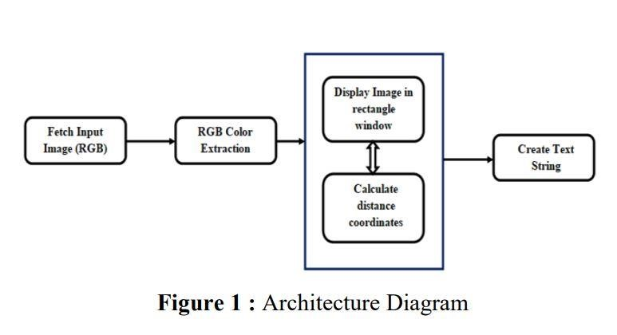
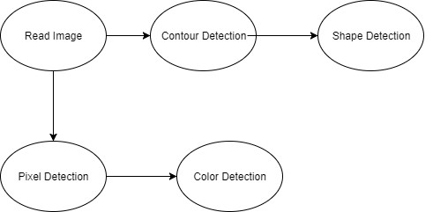
ARCHITECTURE DIAGRAM AND FLOW CHART:
The above architecture shows the capability for the project. It consists of a well-defined sequence diagram that is abstracted from the source code.
It leverages the rich capabilities of the technology such as OpenCV library in python.
architecture makes the process more efficient based on principles and properties related to each other.
The present colour detection project takes the path of an image as an input and looks for the composition of three different colours red, green and blue in the given image.

Slide 9
RESULTS:
This is naive bayes approached in colour detection using pandas and OpenCV. To run this code, we use python language and choose anaconda python tool to compile this code.
And get results we apply only naïve bayes classifier and choose different test options on weka.
But we mentioned only cross validation test mode. Naïve bayes apply on dataset of different column.
Here we present our results. The results are not more sufficient because this technique is used for first time, but in the future, we also apply different algorithms and use R language. But here we mentioned our results.

Slide 10
APPLICATIONS:
To differentiate between crop and soil when using robotics to identify and cut crops.
To determine ripe fruits.
To identify and discard rotten vegetables/fruits using robotic arm.
Traffic signal detection and recognition.
Vehicle colour identification in different light conditions.
Identify wood type based on colour and to determine wall paint colour for repainting.

Slide 11



EXPERIMENTAL RESULTS:
IMAGE 1:
IMAGE 2
IMAGE 3
Original input image of nature.
Output image with Colour intensity RGB values as R=49 G=52 B=21 for Olive Drop.
Output image with Colour intensity RGB values as R=18 G=88 B=186 for Sapphire.

Slide 12
CONCLUSIONS:
In this paper we defined to get the required colour field from an RGB image. And various step are implemented using OpenCV platform.
We learned the way to handle events like double clicking on the window and saw the way to read ARFF files with Weka and CSV files with pandas and apply the OpenCV library to perform operations on data.
Naive Bayes algorithm, Pandas and OpenCV libraries used in python languages.
Using Machine Vision and Machine Learning algorithms, we are able to classify different colour shades under different ideal and non-ideal light conditions like bright light, low/dark light, etc.
Based on the results of both non-ideal conditions, we conclude that different light conditions can alter the colours that machine vision captured and processed further, which can lead to differing colour predictions

Slide 13
FUTURE WORK:
We can extend this project work by adding a few other non-ideal light conditions like,
Sharp/direct focused light,
Direct sunlight/natural light,
Defused white/warm light
Using UV filters to the camera
Also, we can change photo image material like
Matt finished images
Glossy finished image.

Slide 14


